Slide 1
What Science Says About
Becoming Happier
And a few things related to happiness
Positive psychology
GI Joe Fallacy
Happiness myths
Signature strengths & meaningful work / life
Miswanting
Hedonic adaptation
Mindfulness
Flow state
Gratitude
Savouring
Self-compassion
Forgiveness
Secrets to happiness
An overview from two online courses
The Science of Well-being | Yale
The Science of Happiness | UC Berkeley
By Minh Tan

Slide 2
Table of Content [slide # link]
Additional Information
Note slide number at bottom right for quick reference to any content.
Colour of circle matches
sections at left.
Circle links back to this
slide for navigation.
Introduction & background [3]
Happiness myths [13]
Signature Strengths, meaningful work/life [18]
Happiness fallacies & mitigations [23]
Happiness practices [32]
True secrets of happiness [56]
2

Slide 3
The courses
Additional Information
The Science of Well-being
6 weeks + 4 week habit formation assignment
Practical, as much
hands on as theory
NBC report [1:23]
The Science of Happiness
10 weeks over 6 months
In-depth, more theory than hands on and more topics than Yale course
The Science of Well-Being
by Professor Laurie Santos at Yale
The Science of Happiness
Dacher Keltner & Emiliana Simon-Thomas, the Greater Good Center at UC Berkeley
Both online and free!
Both have homework to try happiness practices, and resources for work & life
3

Slide 4
Balanced approach
Additional Information
Look here for more information on topics
of each slide.
Cover topics at a high level, but with
enough details to use and research more
Focus on outcomes, with links in sidebar
at right for more information and scientific details
4

Slide 5
A word of caution
Additional Information
If something doesn’t work for you, give it another chance in the future,
or keep it in mind for suggesting to others.
Research quality is generally good,
but more research is always happening
Results are generalizations for the masses
You can be the exception for any result
What might work for you at a given time
may not later, and vice-versa
It’s complicated!
5

Slide 6
Positive psychology
Additional Information
Martin Seligman TEDTalk on Positive Psychology [23:10]
Positive psychology (Wikipedia)
The 5 Founding Fathers and a History of Positive Psychology
What is and is not
positive psychology?
Positive Psychology Centre at University
of Pennsylvania (UPenn)
Founded by Martin Seligman in 1998,
and contains most research presented here
+
0
-
Positive Psychology
Happiness
Traditional Psychology
6

Slide 7
What influences happiness
Additional Information
Sonja Lyubomirsky: What Determines Happiness? [4:35]
The How of Happiness: A New Approach to Getting the Life You Want, by Sonja Lyubomirsky (book)
7

Slide 8
Baseline happiness
Additional Information
Authentic Happiness Inventory (among many happiness tests, need
to create free account)
PERMA or Positive emotion, Engagement, Relationships, Meaning, Accomplishment (different test from same site above)
Need to know for gauging course impact
Yale course compared you to the masses
in big databases, at start and end of course
(interesting to see where you are)
Berkeley course used weekly comparison among your own results, with their own test
(not available outside course)
8

Slide 9
My happiness baselines
Additional Information
Can an online course on happiness actually boost happiness?
Seems YES!
Authentic Happiness Inventory 3.58 / 5
  76% of web participants
  74% of males (my gender)
  72% of participants in my age group (not sure range used)
  75% of participants in my profession (“other” professional)
  72% of participants in my educational attainment (Masters degree)
PERMA 8.67 / 10
  83% of web participants
  83% of males (my gender)
  79% of participants in my age group (not sure range used)
  83% of participants in my profession (“other” professional)
  82% of participants in my educational attainment (Masters degree)
Berkeley Week 1 Check-in 39 / 60
9

Slide 10
Happiness background
Additional Information
Philosophical & spiritual views [12:28]
A history of the pursuit of happiness
Philosophical and spiritual views through history, and across cultures, given for perspective
Lots in common, but little for clarification,
quantification, replication and causation
Need to define and measure happiness
more specifically for rigour required
to do science
10

Slide 11
Defining happiness
Additional Information
Thinking, Fast and Slow, by Daniel Kahneman [book]
NY Times book review
Daniel Kahneman model has 4 parts (WEST)
  Well-being – life is going well
  Emotion – reverence and gratitude
  Sensation – pleasure
  Traits – mostly genetic (outside of positive psych)
Positive psychology model
  Pleasure – doesn’t last (don’t care for much in field)
  Engagement – engages you
  Meaning – meaningful to you and your life
11

Slide 12
Measuring happiness
Additional Information
Defining and measuring happiness [9:53]
Sonja Lyubomirsky: Pessimism about happiness [5:12]
Objective happiness,
by Daniel Kahneman
Self-response surveys, decent sample sizes
  In the moment (answer at prompts)
  Reflective (think about, like past week, and answer)
Responses often obtained in controlled experiments rather than at random
Some physiological measurements
Happiness can be improved, but not by
means most people think of as solutions
12

Slide 13
Happiness myth - GI JOE Fallacy
Additional Information
The GI Joe Fallacy
(as a cognitive bias) [4:58]
What Scientific Idea is Ready for Retirement?
Coined by Laurie Santos & Tamar Gendler
Knowing is NOT half the battle!
Knowing means nothing if you don’t do anything about it (e.g. diet, exercise, biases)
Knowing what makes you happy won’t make you happy unless you do the work needed
13

Slide 14
Happiness myth – Money
Additional Information
Money and happiness: Income and subjective well-being across nations (book excerpt)
If we are so rich, why aren’t we so happy?
High income, life and emotional well-being
Time over money
for more happiness
Time over money 2
Time, money, and
social connections
Might actually buy you happiness…
but only up to about $75k per year (in US)
After basics of life comfortably taken care of, we just want more and start being unhappy again (universal)
We have more than decades ago…
but our happiness has not increased any
(and possibly decreased)
14

Slide 15
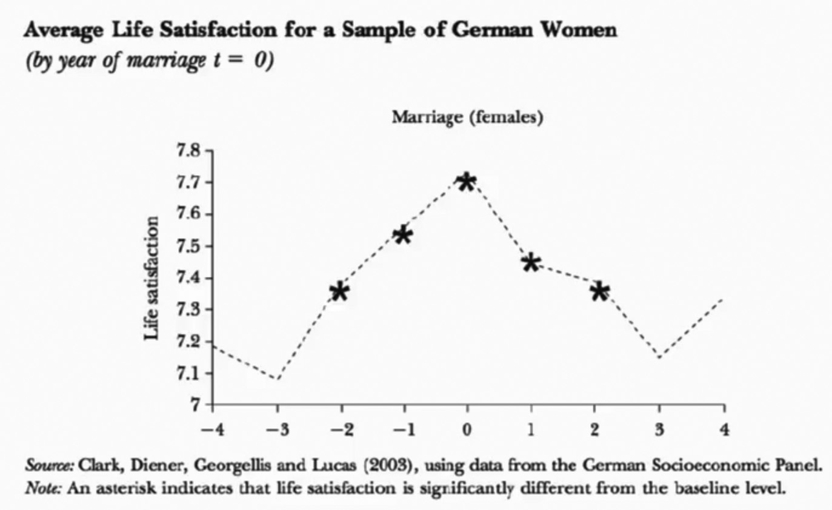
Happiness myth – True love
Additional Information
Happiness reactions
to changes in marital status (book excerpt)
Happier 2 years before & after wedding
15

Slide 16
Other happiness myths
Additional Information
Grades’ minimal impact on happiness
Weight loss and lack
of happiness
Cosmetic surgery
and lack of happiness
Materialist attitudes and worse life satisfaction
Getting or missing out on a job’s impact on happiness
Good grades – NOPE!
Improved looks / body – NOPE!
Awesome purchases like cars – NOPE!
Good job – Maybe…
  Mostly salary – see Happiness myth on money
  Meaningful job – better chance of YES
16

Slide 17
What’s a “meaningful” job?
Additional Information
Free VIA Character Strengths Survey to assess your Strengths
15-30 minutes pending how quickly you answer questions, but be as honest and consistent as possible in how you answer
Highly recommend
for self-knowledge,
and could be very thought provoking
for work and life
Associated with cause dear to someone,
but way too hard to predict for individuals
Scientifically defined in terms of Signature Strengths, which are your strongest
Character Strengths
Determine your strengths with the free
VIA Character Strengths Survey
17

Slide 18
Character Strengths
Additional Information
The Science
of Character [8:04]
24 universal virtues across all cultures
Measured relative to each other ONLY in you, not against anyone else
You can work to improve any of these strengths!
18

Slide 19
24 Character Strengths
Additional Information
VIA Character Strengths descriptions
Video about Character Strength of Perspective
Wisdom
  Creativity
  Curiosity
  Judgment
  Love of learning
  Perspective
Courage
  Bravery
  Honesty
  Perseverance
  Zest
Humanity
  Kindness
  Love
  Social intelligence
Justice
  Fairness
  Leadership
  Teamwork
Temperance
  Forgiveness
  Humility
  Prudence
  Self-regulation
Transcendence
  Appreciation of beauty & excellence
  Gratitude
  Hope
  Humour
  Spirituality
19

Slide 20
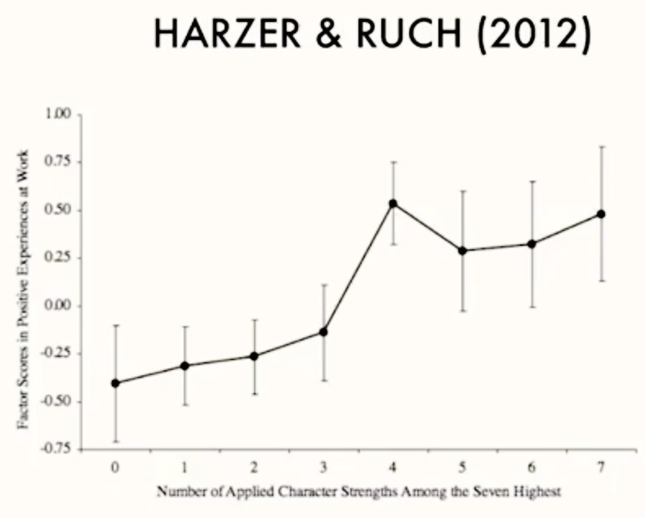
Signature Strengths & Work
Additional Information
Applying Signature Strengths at Work
Impact of Using Signature Strengths
at Work
Click to enlarge
Signature Strengths are your strongest Character Strengths
They are strongest because they are most meaningful to you, whether they are natural to you and/or you worked hard to get them
to the top
A “meaningful” job is one where you use
4-7 of your Signature Strengths
20

Slide 21
My Signature Strengths & Work
Additional Information
When the job
is a calling
Creativity ✓ [wisdom]
Curiosity ✓ [wisdom]
Honesty ✓ [courage]
Hope [transcendence]
Humour [transcendence]
Zest ✓ [courage]
Judgment ✓ [wisdom]
21

Slide 22
Signature Strengths & Life
Additional Information
Is a happy life different from a meaningful one?
Meaningful life can also be defined as one where you use your Signature Strengths often
Paradigm shift I’ve made in my life
No more living with focus on improving weaknesses, but rather exploiting strengths
I am definitely happier for it now!
22

Slide 23
Human happiness idiocy
Additional Information
Stumbling on Happiness,
by D. Gilbert (book)
Nudge: Improving Decisions about Health, Wealth, and Happiness,
by R Thaler & C. Sunstein (book)
Are we really that bad at knowing what we want for happiness? YES!
Why? Four reasons:
  Miswanting (mistaken about what we want)
  Bad comparisons (socially, reference points)
  Hedonic adaptation (adapting to pleasures)
  Lack of hedonic adaptation awareness
23

Slide 24
Miswanting
Additional Information
Affective forecasting: why can’t people predict their emotions?
Miswanting
(book excerpt)
Act of being mistaken about what, and how much, you will like something in the future
Due to poor ability to accurately gauge our emotional reaction to things and events
we imagine about having / experiencing,
from judging initial reaction as enduring
and from lack of details in imagining results
24

Slide 25
Mitigation – think it through
Additional Information
Intensity bias in affective forecasting
Durability bias in affective forecasting
Reexamining durability bias in affective forecasting
Imagine your reaction in more detail
Re-imagine your reaction multiple times with time in between
Recall past reaction to something “similar”, whether in essence or concept
Ask yourself tough questions like why you’d feel that way, or how long would it last
Ask what else you can get for same input
25

Slide 26
Bad comparisons
Additional Information
Social comparison, social media and
self-esteem
Satisfaction and comparison income
$1.40 wanted to be happy for every additional $1.00 earned
Is more always better? A survey on positional concerns
Comparisons to unrealistic references that
are obvious, if we only thought about them
TV and social media bombard us with more chances & people to compare
Our reference changes over time as we “reset” and want more
Relative social comparisons to be better than others around us, even if less for us!
26

Slide 27
Mitigation – better references
Additional Information
See previous slide’s references that also dealt with mitigations to bad comparisons.
Being grateful helps seeing where your situation fits into a spectrum of references, giving you a fair reference point
Lessen or minimize social media and TV
Ask what else you can get for same input
27

Slide 28
Hedonic adaptation
Additional Information
Happiness adaptation to income
Humans are incredibly adaptive to many situations, but especially pleasant ones
Adapt quickly to constants like a salary increase and a new lifestyle, or repetition like the same great meal each night
First time is always biggest thrill,
but thrill diminishes soon after
28

Slide 29
Mitigation – savouring
Additional Information
Future slide on savouring as a general practice for happiness
The act of stepping outside your own experience to review and appreciate it
Tell people about it to “relive” it
Savouring can make things seem to last longer, in the moment and after in retelling
Often leads to gratitude in appreciation,
as does “negative visualization”
Add variation to slow down adaptation
29

Slide 30
Hedonic adaptation blindness
Additional Information
Hedonic adaptation blindness
Unaware of hedonic adaptation happening
This is worse than hedonic adaptation as you’re not even aware of what’s happening
to try and fix it
30

Slide 31
Mitigation – general gratitude
Additional Information
See previous slide’s reference on hedonic adaptation blindness.
You can’t cure something you don’t know
you have
If gratitude resolves hedonic adaptation, general gratitude through life acts as a prevention to hedonic adaptation, whether
you are aware of yourself adapting or not
Whether outright prevention or delaying onset, generally practicing gratitude
is extremely worthwhile
31

Slide 32
What makes us happy then?
Additional Information
Happiness practices are discussed in most of the remaining slides
Happiness practices to be done generally
Like healthy lifestyle choices rather than treatment or cures (fallacy mitigations)
Minimizes overall risks and impacts of things that make us unhappy, before they happen
32

Slide 33
Sleep enough or more
Additional Information
Lack of sleep and
mood disturbance
Sleep inspires insight
Lose Sleep, Lose Your Mind and Health [poster]
Sleep-dependent motor skills learning
Sleep has many benefits (mood, cognitive performance, decreased disease risks)
Try to get 7-8 hours a night, at least time
in bed with a clear or positive mindset,
if not actual sleep that’s hard to track
Set a “bed time alarm” to help, if needed
Employ on and off for stretches of time
if worried about adaptation
33

Slide 34
Mindfulness / meditation
Additional Information
What is mindfulness? [1:58]
Origins of mindfulness [8:01]
Mindfulness Based Stress Reduction (MBSR)
Mindful breathing
Body Scan Meditation
Loving-Kindness Meditation
Mindfulness session
at Google [1:12:15]
A medical stress reduction technique with many physical, mental & emotional benefits
Being fully aware of where we are and not being judgmental to what’s around us
Similar to some forms of meditation, slowing things down and focusing on breathing,
your body, or some object
Can easily be learned
34

Slide 35
Flow
Additional Information
Flow: The psychology of optimal experience, by Mihaly Csíkszentmihályi (book)
Flow theory in less than 5 minutes [4:40]
Animated book review [5:20]
Conceived by Mihaly Csíkszentmihályi
Psychology of optimal experience,
aka being “in the zone”
About focus, under the “right” conditions (next slide), that makes people very happy, with the event actually being a struggle!
Can be used to improve some experiences
from being less than optimal, to optimal
35

Slide 36
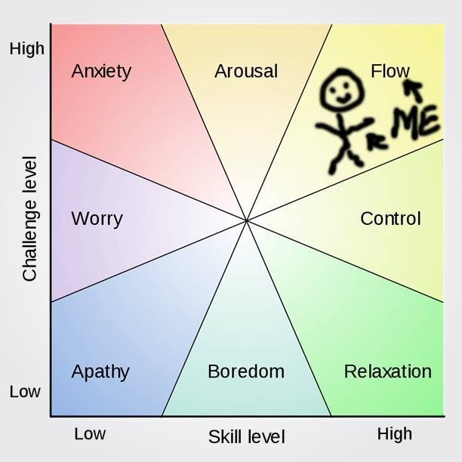
Flow chart
Believe can do this
Believe you have some control over the outcome
Skill level matches challenge level
Get regular feedback
Intrinsic motivation
Additional Information
Can schools help students find flow?
Group flow
Flow, focus & frazzle
[6:23]
Positive feedback helps intrinsic motivation, while money does not
Growth mindset of abilities not being fixed, by Carol Dueck [book]
36

Slide 37
Positive recollection
Additional Information
How to do the Three Good Things exercise
Impact of thinking about life’s positive moments
Take time to think of three good things in
your life on most days (with some details)
Not necessarily same as gratitude as it can stop at recall, not needing more context
Has physical, mental & emotional benefits
Can do it if unable to sleep
37

Slide 38
Gratitude
Additional Information
Gratitude brings happiness [6:38]
Why gratitude is good
Gratitude and subjective well-being
Gratitude and
prosocial behaviour
The power of gratitude [8:12]
Pay it forward (the science of gratitude)
Has physical, mental, emotional,
and social benefits
Many forms, from just thinking about it,
to documenting in a journal, to writing a gratitude letter and reading it to someone
Gives you better reference points in life
Challenges like narcissism, misperceptions like leads to complacency can be overcome
38

Slide 39
Myths about gratitude
Additional Information
Five myths about gratitude
Gratitude in a consumerist society [15:13]
Gratitude letter exercise instructions
Gratitude journal exercise instructions
Gratitude and
spousal relations
Some don’t feel comfortable with gratitude
from misconceptions they associate with it:
  Leads to complacency
  Naïve form of positive thinking
  Makes one too self-effacing
  (give credit to others for your own success)
  Not possible/appropriate in adversity/suffering
  Have to be religious
39

Slide 40
Scaling gratitude
Additional Information
Gratitude in schools [16:08]
How to foster gratitude in schools
Gratitude in romantic relationships [14:53]
Gratitude is for lovers
Gratitude & division of labour in relationships
Gratitude at work
Gratitude in adversity
Lots of habits you can employ
Lots of situations in which you can employ:
  School
  Relationships
  Work
  Adversity
Lots of benefits everywhere!
40

Slide 41
Savouring
Additional Information
Other slide on savouring
Impact of savouring through a daily diary
Covered previously, but you don’t need
to wait until you have a pleasant situation
to savour to mitigate hedonic adaptation
Apply to as many situations as you can
to enjoy life more
Has mental and emotional benefits, but
can be a catalyst for other practices like gratitude or positive thinking
41

Slide 42
The “awe” walk
Additional Information
The science of awe [9:40]
Can awe buy you more time and happiness?
How awe transforms the mind [start 18:22]
Can awe boost health?
Awe walk instructions
Cultivating awe with a walking meditation
Four awe-inspiring activities and benefits
There’s just something that makes people happy when in awe of something else
Cultivate “awe” by noticing & appreciating
all the wonders around you, grand or not,
while doing a walk or something else
Has mental and emotional benefits,
and physical benefits in a walk
Relatively new frontier of research
42

Slide 43
Exercise
Additional Information
The brain-changing benefits of exercise TEDTalk [13:02]
Benefits are too long to list, but includes many mental & emotional, not just physical
Any movement is good, but aerobic
exercises that get you a bit out of breath
is better, preferably 30+ minutes 3-4 times
a week
Doesn’t need to be formal exercise, like gym, can just be dancing in living room
43

Slide 44
Natural / unstructured play
Additional Information
The Hopscotch Experiment [3:26]
Play and the pursuit
of happiness [6:55]
Can we play?
We have lost our sense of good
old-fashioned fun from natural play,
especially adults
Kids need some of this, too
Has physical, mental, emotional,
and social benefits
Often get laughter and exercises as bonus happiness practices with this
44

Slide 45
Laughter
Additional Information
Functions & benefits
of laughter [9:14]
Why do we laugh?
Ha! The Science of When We Laught and Why, by Scott Weems [book]
Laughter is called the “best medicine”
for very good reasons
Besides exposure to funny situations you
may seek out or encounter, just try to
laugh more often, and laugh more heartily
Has physical, mental, emotional benefits,
and social benefits if done among others
45

Slide 46
Social connections
Additional Information
Social ties & health
Social ties & happiness
Happiness from talking to strangers
Sharing experiences
makes them better
5 ways oxytocin shapes your social life
Touch & happiness [7:28]
Science of touch
Making friends is better than making grades
We are evolutionarily wired to connect
Has physical, mental, emotional,
and social benefits
Huge variance on optimal # connections,
but quality is more important than quantity
Start young better (making friends is more important than making grades), but we can
adapt to be more social any time
46

Slide 47
Kindness / compassion
Additional Information
Science of compassion [9:02]
What’s good about compassion? [14:12]
Measuring compassion
Biology of kindness
and happiness [5:02]
Evolutionary roots
of kindness [6:59]
Compassionate instinct
Kids & kindness
Has physical, mental, emotional,
and social benefits
We are mostly wired to be caring, but even those who aren’t can be changed
Can be practiced as deliberate or random,
big or small, but more frequent is better
Should be sincere or else will feel superficial and may reduce happiness
47

Slide 48
Kindness / compassion II
Additional Information
Random Acts of Kindness (RAKs) [6:30]
RAK instructions
Happiness through counting kindness
Spending money on others promotes happiness
Happy Money, by Elizabeth Dunn [book on previous concept]
Prosocial spending and universal well-being
More references for kindness
and compassion
Very solid this really helps happiness a lot
48

Slide 49
Self-compassion
Additional Information
Three components to self-compassion [6:19]
Self-compassion website of Kristin Neff
Self-compassion exercises
Compassion you might show others, but to yourself instead of being hard on yourself
Three components
  Self-kindness vs self-judgment
  Community vs isolation
  Mindfulness vs over-identification
There are right and wrong times for this
Physical, mental, emotional & social benefits
49

Slide 50
Your best possible self
Additional Information
Best possible self exercise instructions
Imagining the best possible life for
yourself in the future, with specific
details, and write about it
Positive thinking with clarity about
some big things in your life
Mental and emotional benefits
Try not to compare to your life today
50

Slide 51
Your life narrative
Additional Information
The power of narrative [6:04]
How stories change
the brain
Stories are core to humanity
How you see yourself can be good for you,
as well as others because if you don’t see yourself well, why should they?
Write a brief life narrative, or just some part of your life, and refine it for perspective,
not facts, to be more positive
Has mental, emotional, social benefits
51

Slide 52
Active (empathetic) listening
Additional Information
Evolution of empathy
6 habits of highly empathetic people
Active listening instructions
Listening in an engaged way, with empathy and without judgement, then reverse
with partner
Need someone to share things with you,
and listen in return, even if only 10 minutes
Doesn’t need to be about big or intimate problems, or even problems
Can be really good for relationships
52

Slide 53
Cooperation
Additional Information
Evolutionary psychology of cooperation [11:30]
Neuroscience of cooperation [9:32]
Cooperation in the animal kingdom and what we can learn
from it
Has mental and emotional benefits
Hard for me to separate from social connection and kindness sometimes,
because many social connections are
about doing things together
Kindness isn’t always only you helping someone else, but doing together
Forced cooperation is not fun!
53

Slide 54
Forgiveness / being forgiven
Additional Information
What forgiveness means [6:23]
Forgiveness instinct
Science of forgiveness [5:05]
New science
of forgiveness
Four parts of an effective apology
Nine steps
to forgiveness
Is not about condoning an action, absolving responsibilities, liking the person, etc.
Just about being able to let it go
Has physical, mental, emotion, social benefits
Can be very hard to do but big benefits
Has to be sincere, though there are methods
to help communicate that sincerity better
54

Slide 55
Using Signature Strengths
Additional Information
Impact of using Signature Strengths
Authentic Happiness, by Martin Seligman [book, chpt 8-10]
Use your Signature Strengths more often,
in some random mix rather than in routine
Can have physical, mental, emotional
and/or social benefits pending what
you do
Makes your life more meaningful,
and more interesting
55

Slide 56
True secrets to happiness
Additional Information
Happiness takes work [2:14]
You have to work at it, doing the happiness practices regularly
Find the practices that work for you
Make them habitual rather than conscious
Don’t think about becoming happier often
Mix up practices you do regularly
56

Slide 57
Finding your happiness fit
Additional Information
Person activity fit [9:40]
What happiness habits are right for you?
Try all the practices to see which works
well for you and use those most often
as they are most “right” for you
Things will also change over time as you
may come to like some more or less
Figure out frequencies that works for you,
if you have that choice, and just do some
if you don’t like being short on time
57

Slide 58
Habit formation
Additional Information
Goal specificity & improved performance
Self-regulation
for sticking to goals
WOOP Character Lab and how to WOOP
WOOP for exercise
Aim to turn doing happiness practices into
a habit (minimal reminders) as they’ll be a chore otherwise and not leave you happy
Use methods like WOOP (Wish, Outcome, Obstacle, Plan) to help develop habits
Make sure motivations are intrinsic (for self and/or enjoyment, not $, fame, bragging rights, trying to become happier, etc.)
58

Slide 59
Don’t think about happiness
Additional Information
Advice on not thinking about becoming happier often, and consequences, was given by Professor Laurie Santos in one
of her course lectures.
If that were not obvious, the two mentions for goals
of happiness should
be intuitively sensible.
Constantly thinking about happiness
and/ or becoming happier, will lead
to insanity, or at least neuroticism
Goal is NOT constantly increasing
or having much happiness all the time
Goal is higher average and less variation
in happiness over time, and stronger/faster rebound from unhappy circumstances
59

Slide 60
Mixing it up
Additional Information
Part of activity fit resources, but also mentioned separately in video lectures not available outside of courses.
Person activity fit [9:40]
What happiness habits are right for you?
Vary happiness practices you do to some extent, with random being better but likely need some planning for habit formation
Thwarts hedonic adaptation
Keeps things interesting as variety
is also the spice of happiness
60

Slide 61
My happiness end results!
Additional Information
Authentic Happiness Inventory (among many happiness tests, need
to create free account)
PERMA or Positive emotion, Engagement, Relationships, Meaning, Accomplishment (different test from same site above)
Authentic Happiness Inventory 3.83 / 5
  87% of web participants [76%]
  85% of males (my gender) [74%]
  84% of participants in my age group (not sure range used) [72%]
  86% of participants in my profession (“other” professional) [75%]
  84% of participants in my educational attainment (Masters) [72%]
PERMA 8.71 / 10
  83% of web participants [83%]
  83% of males (my gender) [83%]
  79% of participants in my age group (not sure range used) [79%]
  83% of participants in my profession (“other” professional) [83%]
  82% of participants in my educational attainment (Masters) [82%]
Berkeley Week 10 Check-in 55 / 60
61

Slide 62
QUESTIONS?
☺
62

Slide 63
Click here to return to original slide

